Slide 1
영화예매 프로그램
- Lee_Movie -
By 이상화

Slide 2
목 차
Project Name
Event diagram
User Action diagram
Dialog design
Table Schema

Slide 3
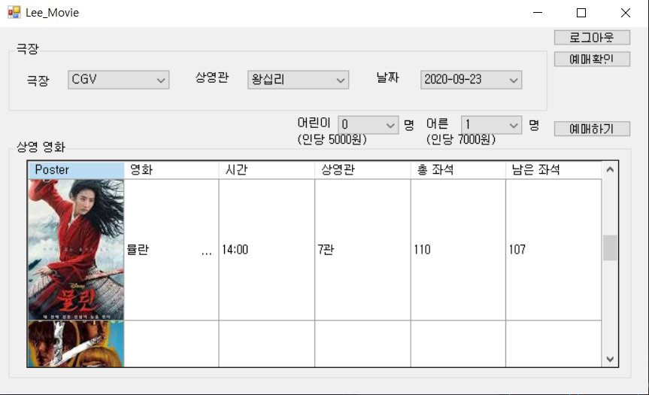
Project Name
영화 예매 프로그램 –Lee Movie-

Slide 4
Event diagram
Login Part
Login success
WritePrivateProfileString
ini File ID Save
Login_Status => Change
Main Form
=> Wait User Action

Slide 5
Event diagram
Pass Find Part
ID/Email Match Success
Generate 6 secure code
=> Send Email
Secure Insert Form
=> Wait User Input

Slide 6
Event diagram
Reservation Part
Payment Success
DB’s UPDATE
Gridview Refresh
Main Form
=> Wait User Action

Slide 7
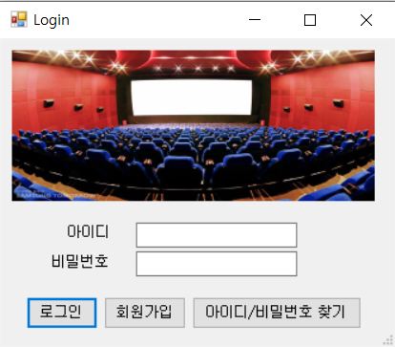
User Action diagram
Login Part
Login Button
Login
Sign Up
ID/Password Find
DB Open CustomerInfo Table
Login success
Join
ID or Pass Find
Movie Select Part

Slide 8
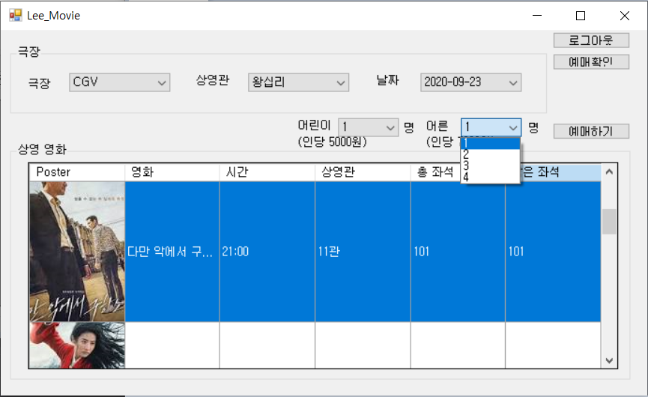
User Action diagram
Movie Select Part
Login Success
DB Open
Movie Table
Screen Select
Location Select
Day Select
Movie List Select
People Select
Reservation
Seats Select Part

Slide 9
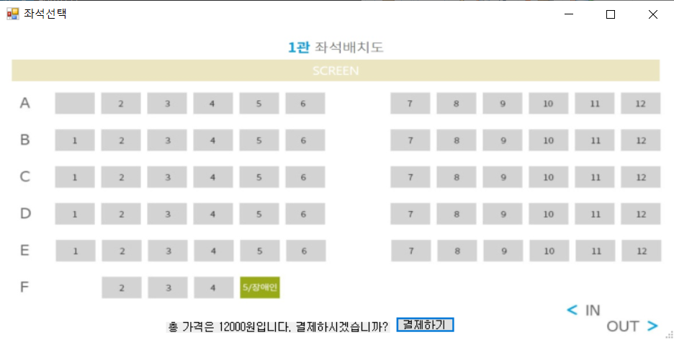
User Action diagram
Seats Select Part
Reservation
Seats, Price
Payment
CustomerInfo Table
Movie Table
UPDATE
Movie Select Part

Slide 10
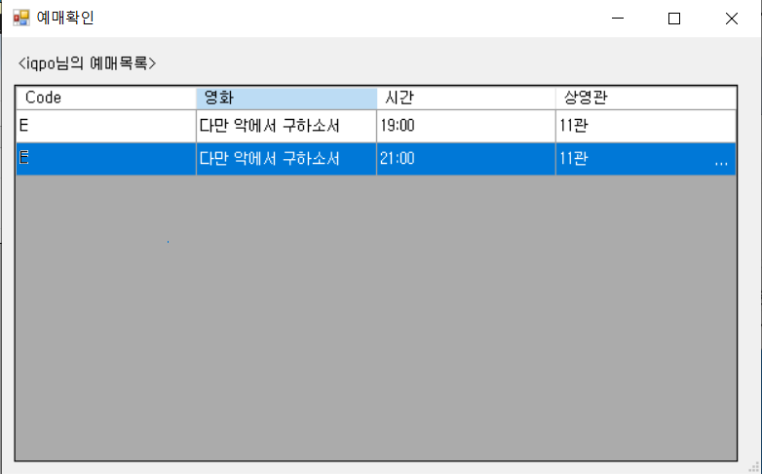
User Action diagram
Reservation Check Part
Reservation Check Button
DB Open
CustomerInfo Table
Reservation Check

Slide 11
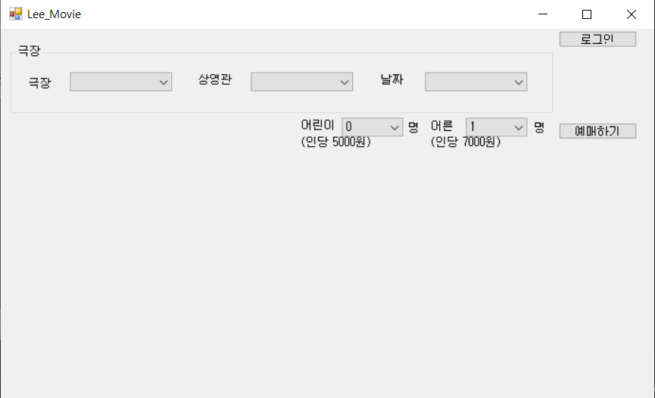
Dialog design
Main Form

Slide 12
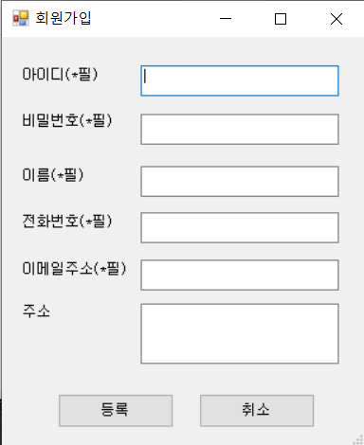
Dialog design
Login Form
Join Form

Slide 13
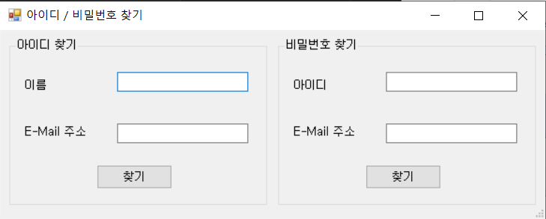
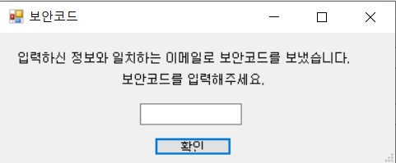
Dialog design
ID/Pass Find Form
Secure Code
Confirm Form

Slide 14
Dialog design
Seat Form
Reservation
Check Form

Slide 15
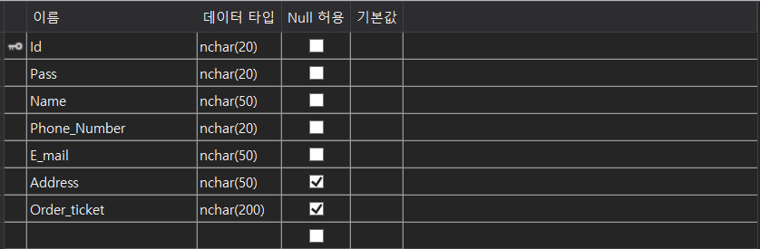
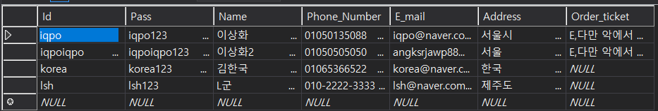
Table Schema
CustomerInfo

Slide 16
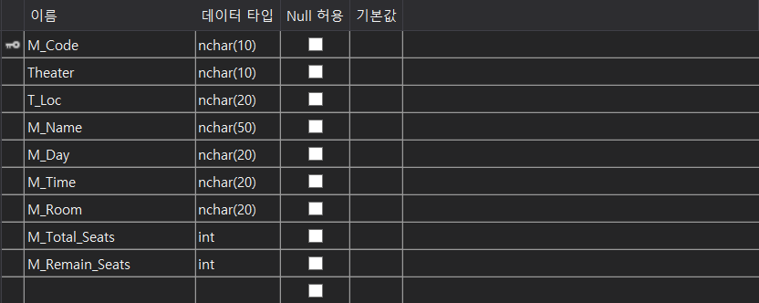
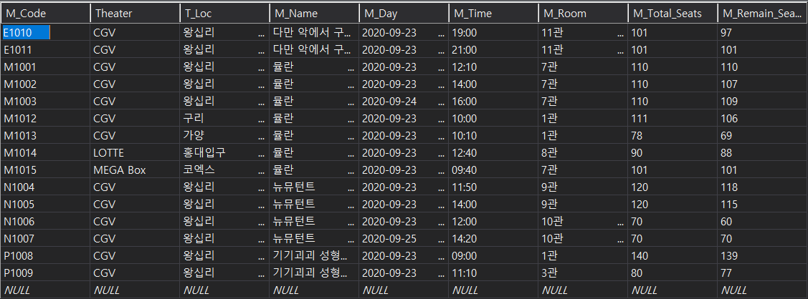
Table Schema
Movie

